Slide 1

Indian Government Dataset Analysis
Industry Wise Sanctions for the Year 2022-2023
M. VAISHNAVI
2211CS010336

Slide 2
Dataset Overview
• The dataset contains industry-wise government funding details for 2022-2023.
• Key columns: Serial No, Industry Name, Investment Amount (Rs in Crore).
• Total 46 rows and 8 columns, but only 16 rows contain valid financial data.
• Used for analyzing funding trends, economic impact, and industry priorities.

Slide 3
Data Cleaning & Preprocessing
• Removed 5 empty columns (Unnamed: 3 to Unnamed: 7).
• Converted ‘Rs in Crore’ column to numeric format for accurate calculations.
• Checked for missing values and handled inconsistencies.
• Verified data integrity before performing further analysis.

Slide 4
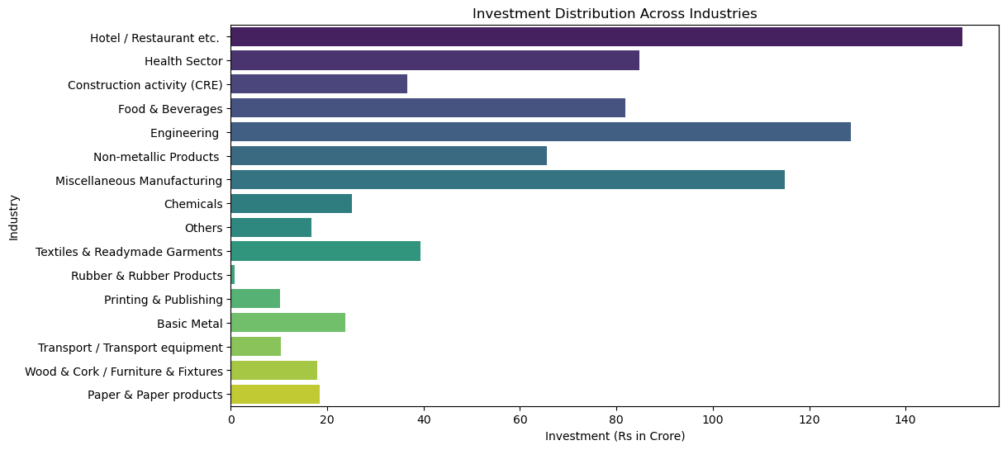
Data Visualization
The bar chart illustrates the distribution of investments across various industries in
Rs. Crore for the year 2022-2023. The Hotel/Restaurant sector received the highest funding, followed by Engineering and Miscellaneous Manufacturing industries.

Slide 5
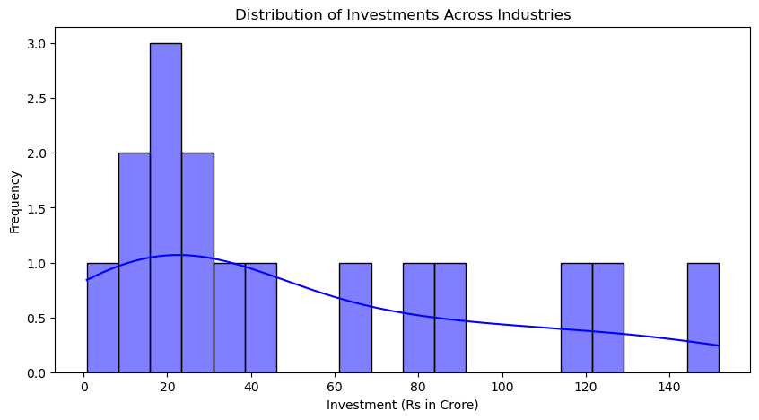
Data Visualization
The histogram displays the distribution of investments across industries, showing that most industries received lower investments, while a few had significantly higher allocations. The KDE curve highlights a right-skewed trend, indicating a concentration of lower investment values.

Slide 6
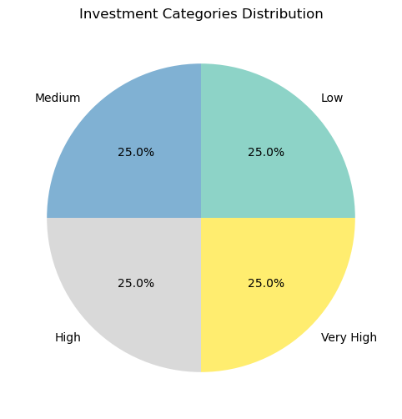
Data Visualization
The pie chart represents the distribution of investment categories, with equal allocations of 25% for each category: Low, Medium, High, and Very High. This suggests a balanced investment strategy across different levels of funding.

Slide 7
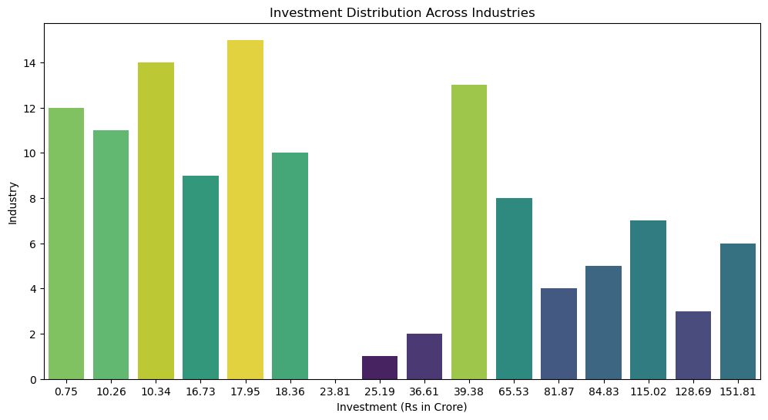
Data Visualization Output
The bar chart represents the distribution of investments across various industries, with investments measured in crores on the x-axis and corresponding industry indices on the y-axis. The varying bar heights and colors suggest differences in investment levels among industries.

Slide 8
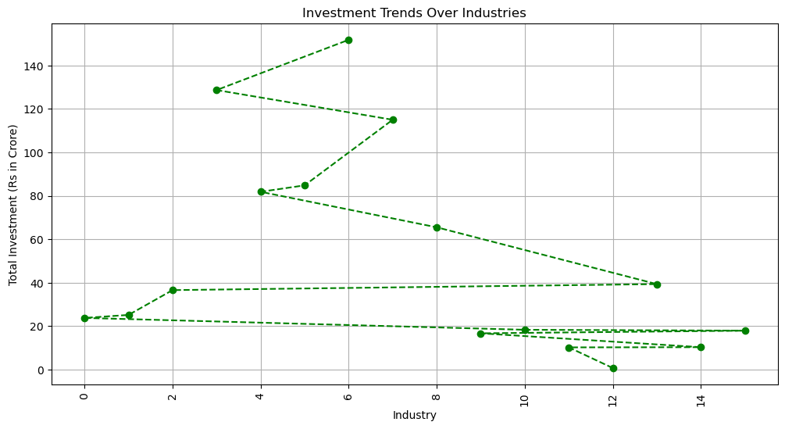
Data Visualization Output
The line chart visualizes investment trends across various industries. The x-axis represents different industries, while the y-axis indicates total investment in crores. The dashed lines with markers suggest fluctuations in investment patterns, highlighting industries with higher and lower financial allocations over time. Let me know if you need any modifications or insights from the data!

Slide 9
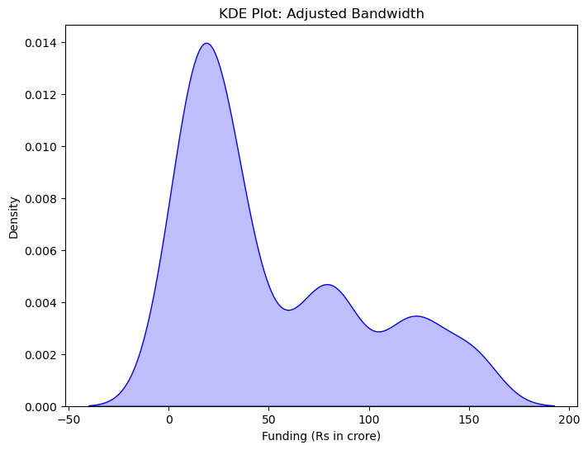
Data Visualization Output
This KDE plot visualizes the probability density of funding amounts (in crores), showing a right-skewed distribution with peaks around 0, 50, and 100 crores. The shaded region highlights the density, and the adjusted bandwidth smooths the curve for better interpretation.

Slide 10
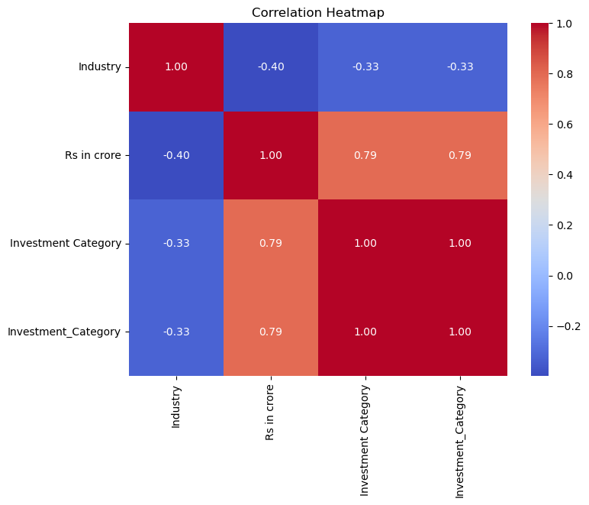
Data Visualization Output
This correlation heatmap visualizes the relationships between different variables, with values ranging from -1 (strong negative correlation) to 1 (strong positive correlation). The funding amount (Rs in crore) has a strong positive correlation (~0.79) with investment categories, while the industry variable shows a moderate negative correlation with other variables.

Slide 11
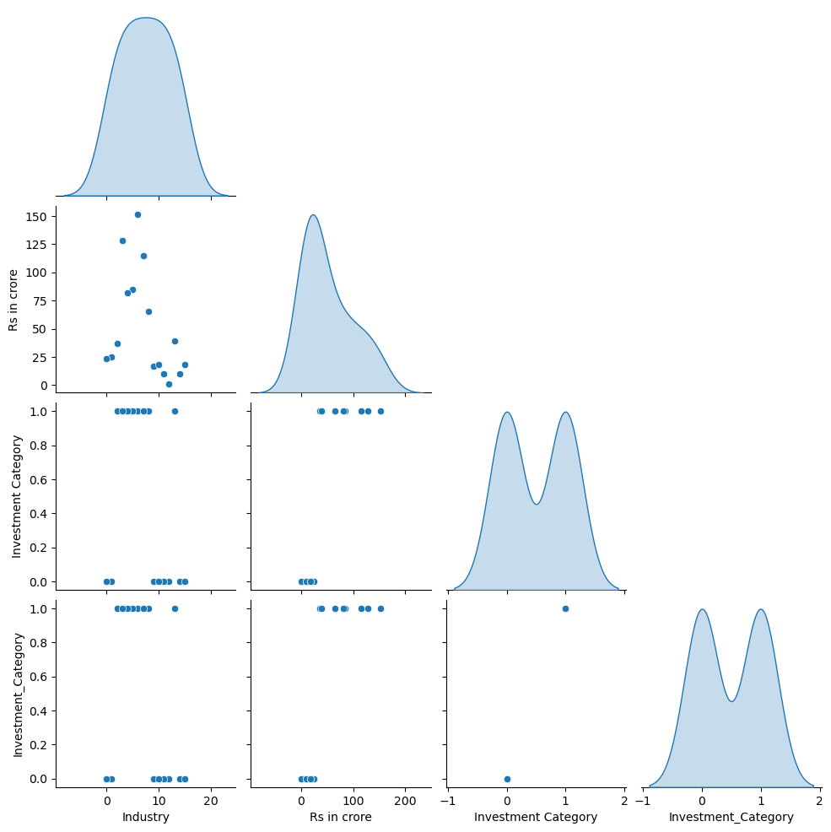
Data Visualization Output
This pair plot visualizes relationships between variables using scatter plots and KDE distributions on the diagonal. It highlights data distributions, potential correlations, and clustering patterns, especially for funding amounts and investment categories.

Slide 12
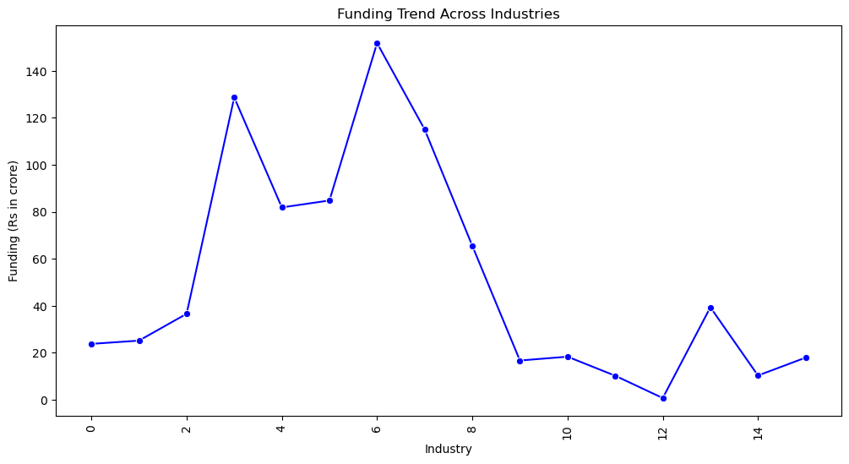
Data Visualization Output
This line plot shows funding trends across different industries, varying funding distributions, with some industries receiving significantly more funding than others.

Slide 13
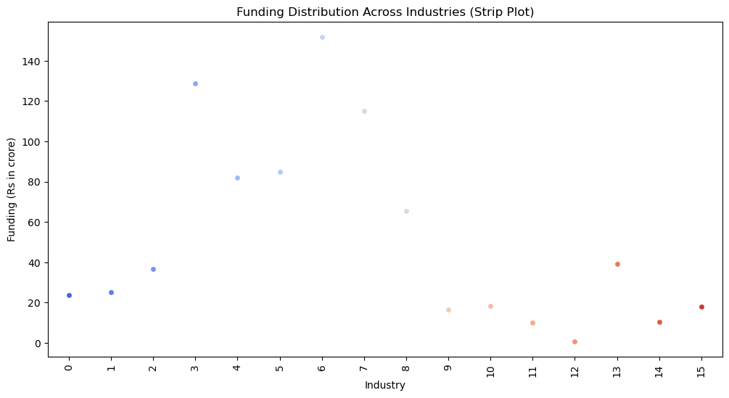
Data Visualization Output

Slide 14
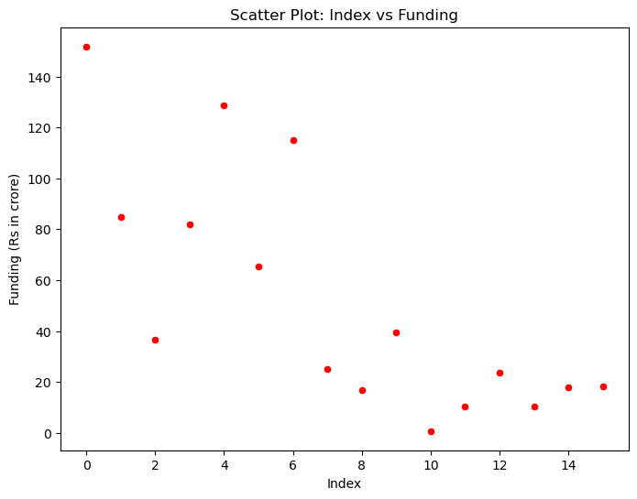
Data Visualization Output

Slide 15
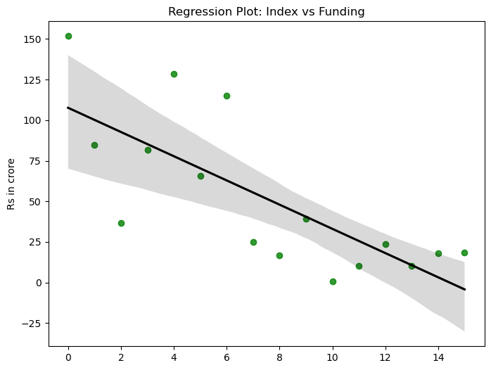
Data Visualization Output

Slide 16
Key Insights from Analysis
• Significant investment disparities exist across industries.
• Hospitality, Engineering, and Manufacturing receive the highest funding.
• Smaller sectors like Rubber and Printing receive minimal investment.
• Regression analysis shows a strong correlation between industry type and investment amounts.

Slide 17
Recommendations for Future Analysis
• Implement a long-term investment tracking system to observe trends.
• Improve funding allocation for underfunded sectors.
• Analyze multi-year funding patterns for deeper insights.
• Enhance machine learning models to predict optimal fund allocation.

